Slide 1
B-Tree
Session 21
Anang Prasetyo, S.Kom., M.Kom.

Slide 2
Learning outcomes
At the end of this session, students will be able to:
LO 1: Explain the concept of data structures and its usage in Computer Science
LO 2: Illustrate any learned data structure and its usage in application
LO 3: Apply data structures using C

Slide 3
Subtopics
B-Tree Concept & Application
B-Tree Property
2-3 Tree
Operations: Search, Insert, Delete
B-Tree Order 4 & 5
B-Tree Order 4 & 5 Operations

Slide 4
B-TREE CONCEPT & APPLICATION
Concept
B-Tree is defined as a data structure that facilitates faster access of data that are stored in the secondary memory by creating and using indexes for accessing a huge amount of data in database.​
This is similar to using indices in a book to access related contents in a rapid manner.​
B-Tree is suitable for creating a dictionary by storing keys and records so that by providing a key, one can access the corresponding record.​

Slide 5
B-TREE CONCEPT & APPLICATION
Concept
As a BST has one value in each node, and two subtrees, it has a degree of two.​
Hence, a BST can be called as a two-way tree.​
The finding above, can be generalized to an M-way tree, where M is the number of children that a node can have.​
M is also known as the branching factor.​
An M-way tree is a data structure that has the following property:​
Each node of an M-way tree has M-1 values or keys per node​
Each node of an M-way tree has M subtrees​

Slide 6
B-TREE CONCEPT & APPLICATION
Applications
A B-Tree is a balanced M-way search tree with the main objective to reduce the access time and help in index organization in a database.​
B-Tree helps to reduce the search time from O(n) to O(log n) by balancing the M-way search trees.​

Slide 7
B-TREE PROPERTY
A B-Tree of order m has the following property:
Every node has at most m children.
Every node (except root) has at least m/2 children.
The root has at least 2 children if it is not a leaf.
A non leaf node with k children contain k-1 keys.
All data are kept in sorted order.
All leaves are at the same level (the bottom level).

Slide 8
B-TREE 2-3
B-Tree with order m of: 3 is also called as 2-3 Tree, which satisfies the following property:
Each internal node (non leaf) is either a 2-node or a 3-node.
2-node : has one data and two children (left and middle child)
3-node : has two data and three children (left, middle and right child)
All data are kept in sorted order.
Let A be the data stored in a 2-node. Left sub-tree should contain data less than A, middle sub-tree should contain data greater than A.
Let A and B the data stored in a 3-node. Left sub-tree should contain data less than A, middle sub-tree should contain data greater than A and less than B, right sub-tree should contain data greater than B.
All leaves are at the same level (the bottom level).

Slide 9
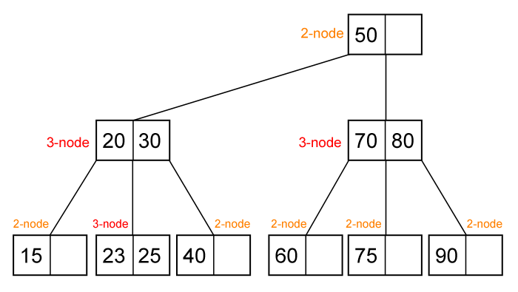
B-TREE 2-3
2-3 Tree : Example

Slide 10
Operations: Search, Insert, Delete
2-3 Tree OPERATION : SEARCH
Because all data in 2-3 tree are stored in sorted order, searching in 2-3 tree is easy. We can extend the search algorithm for binary search tree to obtain the search algorithm in 2-3 tree.
find(ptr, x)
If ptr is NULL then not found
If x = A then found
If x < A then find(ptr->left, x)
If ptr is 3-node
If x = B then found
If A < x and x < B then find(ptr->middle, x)
If B < x then find(ptr->right,x)

Slide 11
Operations: Search, Insert, Delete
2-3 Tree OPERATION : SEARCH
Because all data in 2-3 tree are stored in sorted order, searching in 2-3 tree is easy. We can extend the search algorithm for binary search tree to obtain the search algorithm in 2-3 tree.
find(ptr, x)
If ptr is NULL then not found
If x = A then found
If x < A then find(ptr->left, x)
If ptr is 3-node
If x = B then found
If A < x and x < B then find(ptr->middle, x)
If B < x then find(ptr->right,x)

Slide 12
Operations: Search, Insert, Delete
2-3 Tree OPERATION : INSERTION
Supposed we want to insert a new data key.
First we should find where key should be placed in 2-3 tree using search algorithm, it will be in one of the leaf.
If the leaf is 2-node then simply put the new key there (so it’s become a 3-node).
If the leaf is already a 3-node push the middle data between A, B and key (A and B are two data in that 3-node) to its parent and split the two remaining data into two 2-node. Recursively fix the parent.

Slide 13
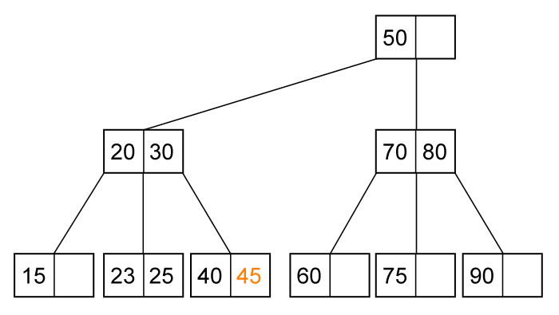
Operations: Search, Insert, Delete
2-3 Tree OPERATION : INSERTION EXAMPLE
Insert (45). The leaf is a 2-node, just put (45) there.

Slide 14
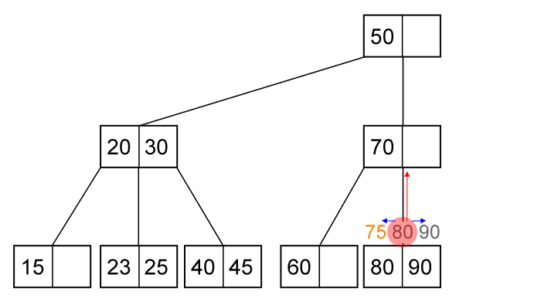
Operations: Search, Insert, Delete
2-3 Tree OPERATION : INSERTION EXAMPLE
Push the middle value (80) to its parent and split 75 with 90.

Slide 15
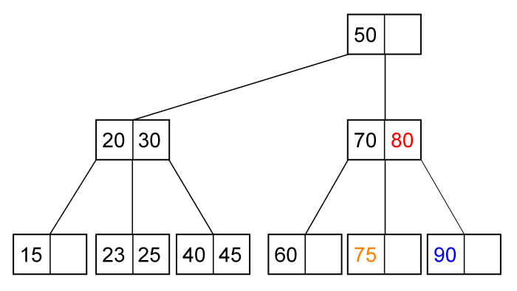
Operations: Search, Insert, Delete
2-3 Tree OPERATION : INSERTION EXAMPLE
2-3 tree after insertion of (75)

Slide 16
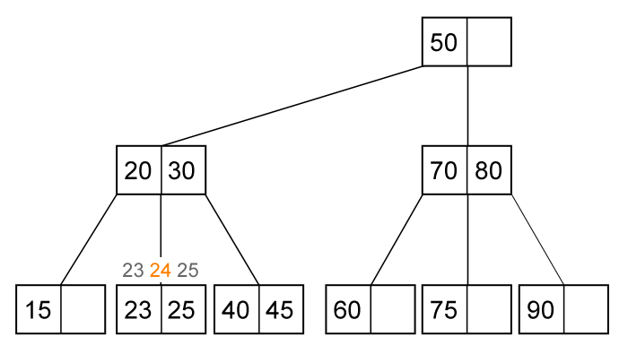
Operations: Search, Insert, Delete
2-3 Tree OPERATION : INSERTION EXAMPLE
Insert (24). The leaf is 3-node. Push the middle value (24) to its parent.

Slide 17
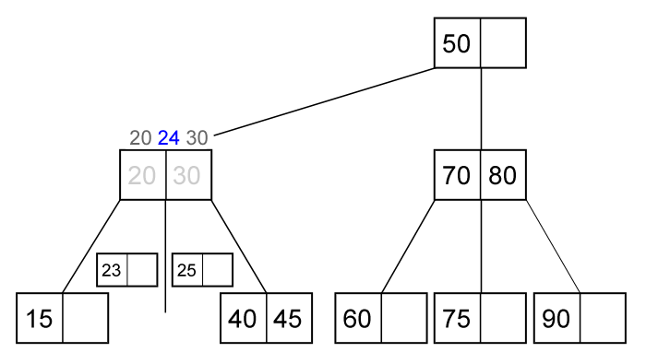
Operations: Search, Insert, Delete
2-3 Tree OPERATION : INSERTION EXAMPLE
Its parent is also a 3-node. Push the middle value (24) to its parent.

Slide 18
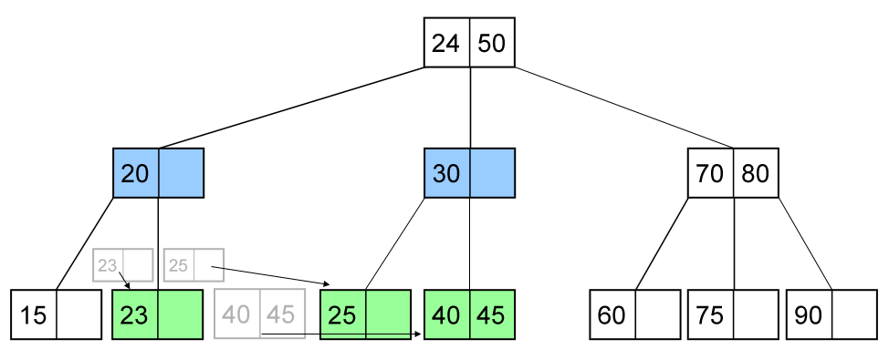
Operations: Search, Insert, Delete
2-3 Tree OPERATION : INSERTION EXAMPLE
2-3 tree after insertion of (24)

Slide 19
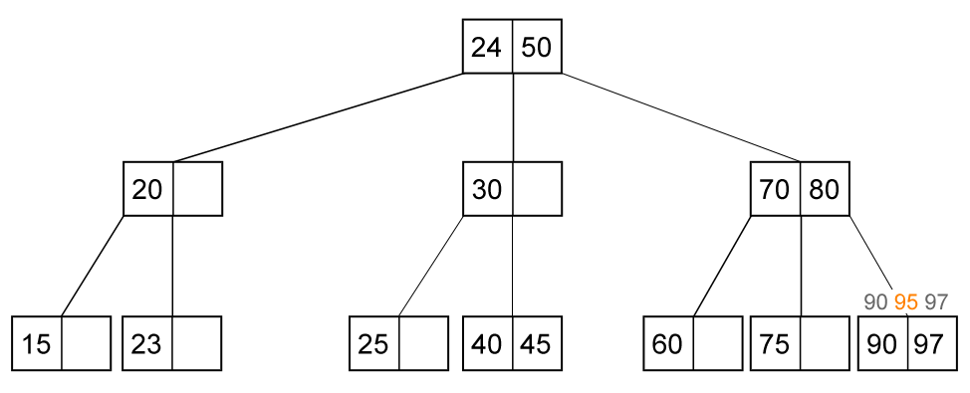
Operations: Search, Insert, Delete
2-3 Tree OPERATION : INSERTION EXAMPLE
Insert (95). The leaf is a 3-node. Push the middle value (95) to its parent.

Slide 20
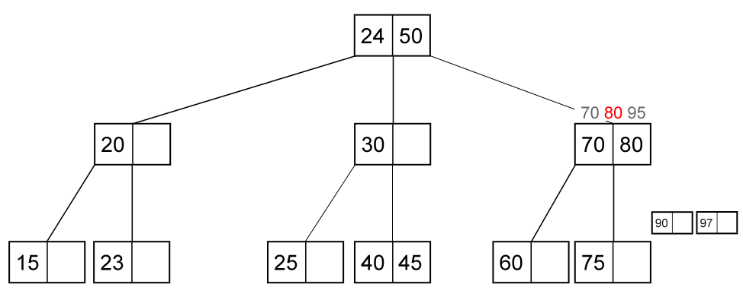
Operations: Search, Insert, Delete
2-3 Tree OPERATION : INSERTION EXAMPLE
Its parent is also a 3-node. Push the middle value (80) to its parent.

Slide 21
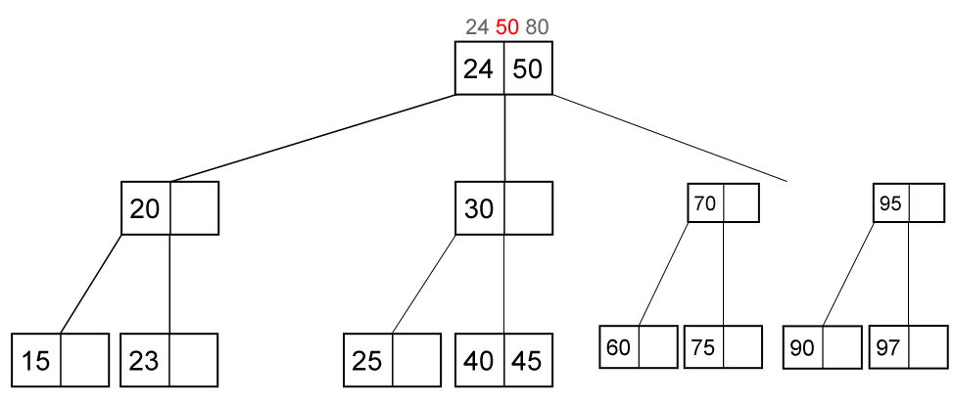
Operations: Search, Insert, Delete
2-3 Tree OPERATION : INSERTION EXAMPLE
The root is also a 3-node. Push the middle value (50) to be a new root.

Slide 22
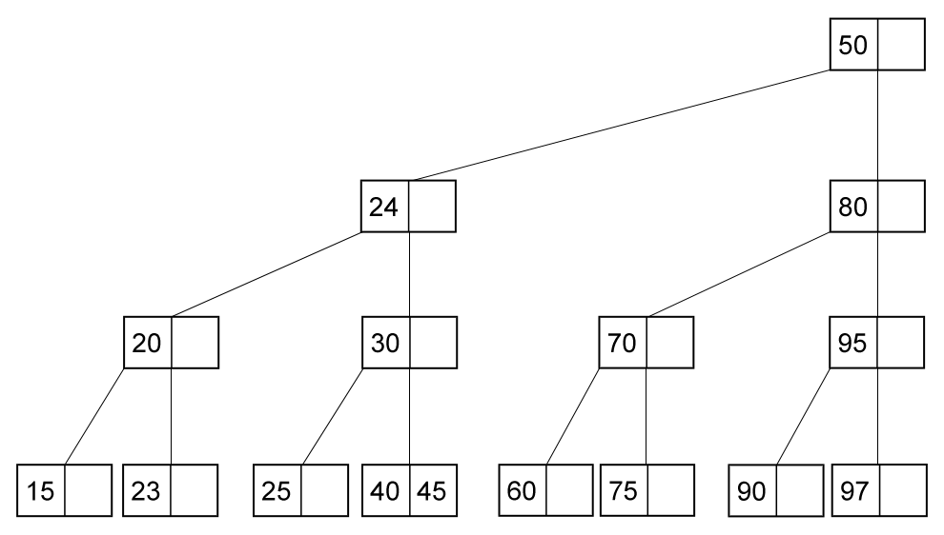
Operations: Search, Insert, Delete
2-3 Tree OPERATION : INSERTION EXAMPLE
2-3 tree after insertion of (95)

Slide 23
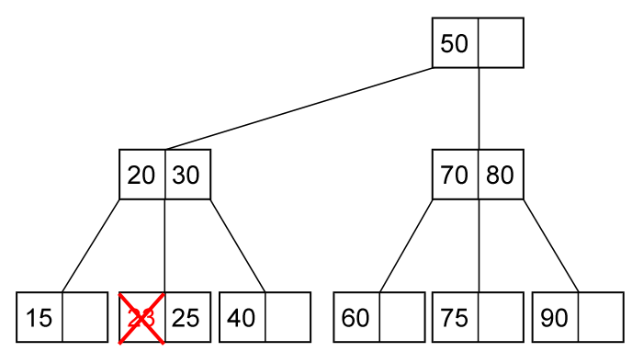
Operations: Search, Insert, Delete
2-3 Tree OPERATION : DELETION EXAMPLE
Delete (23). The node is at leaf and the leaf is 3-node. Just delete it.

Slide 24
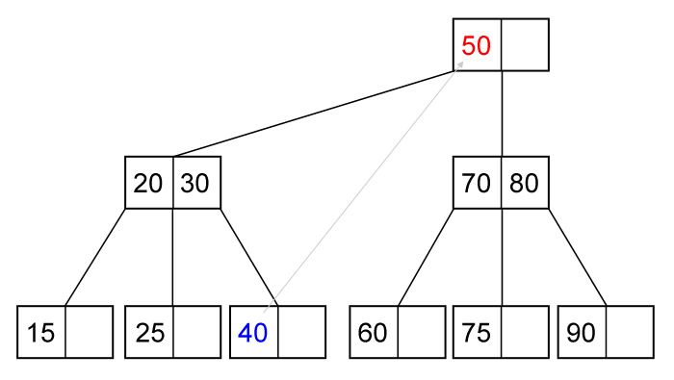
Operations: Search, Insert, Delete
2-3 Tree OPERATION : DELETION EXAMPLE
Delete (50). Replace (50) with (40), and delete (40) at the leaf (a 2-node).

Slide 25
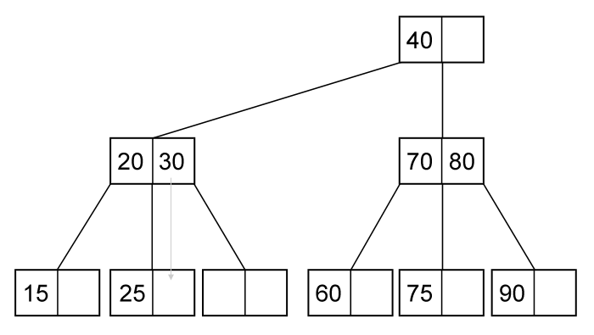
Operations: Search, Insert, Delete
2-3 Tree OPERATION : DELETION EXAMPLE
Parent is a 3-node but sibling is 2-node. Merge (25) and (30).

Slide 26
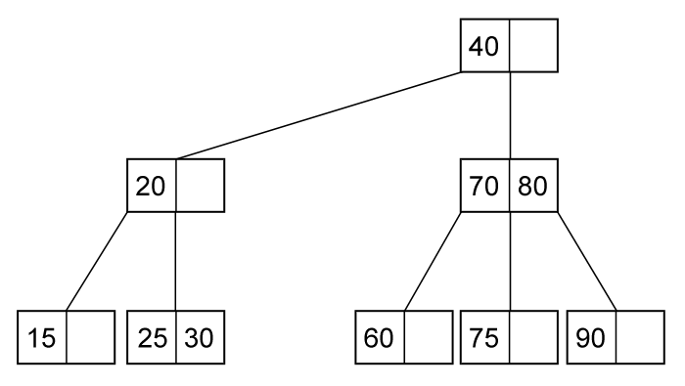
Operations: Search, Insert, Delete
2-3 Tree OPERATION : DELETION EXAMPLE
2-3 tree after deletion of (50)

Slide 27
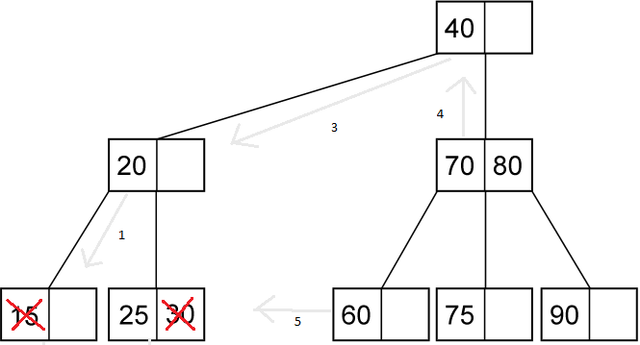
Operations: Search, Insert, Delete
2-3 Tree OPERATION : DELETION EXAMPLE
2-3 tree after deletion of (30) and (15)

Slide 28
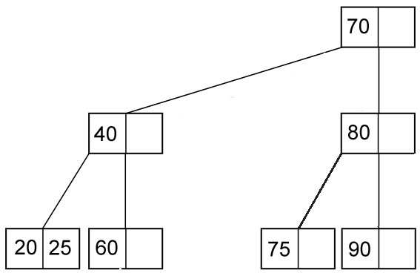
Operations: Search, Insert, Delete
2-3 Tree OPERATION : DELETION EXAMPLE

Slide 29
B-tree order 4-5
B-tree is a special type of self-balancing search tree in which each node can contain more than one key and can have more than two children. It is a generalized form of the binary search tree.
B-tree order 4-5 can have maximum child until 5.

Slide 30
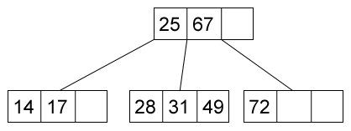
B-tree order 4-5
ORDER 4 EXAMPLE

Slide 31
Operations : Search, Insert, Delete
4 – 5 Tree operation : SEARCH
Searching in B-Tree holds the same principle as in 2-3 tree.
find(ptr, x)
if ptr is NULL then return not found
if x < ptr->data[0] then find(ptr->child[0], x)
if x = ptr->data[0] then return found
for i = 1 to m do
if ptr->child[i] is not NULL
if x = ptr->data[i] then return found
if ptr->data[i-1] < x and x < ptr->data[i] then
return find(ptr->child[1], x)
if ptr->data[m] < x then return find(ptr->child[m], x)
return not found

Slide 32
Operations : Search, Insert, Delete
4 – 5 Tree operation : INSERTION
Supposed we want to insert a new data key.
First, we should find where key should be placed in B-tree using search algorithm, it will be in one of the leaf.
If the leaf contain less than m-1 data then insert the new key there.
Otherwise, push the middle data to its parent and split the left side and right side of the middle data. Recursively fix the parent.

Slide 33
Operations : Search, Insert, Delete
4 – 5 Tree operation : INSERTION EXAMPLE
f
full, split
Insert (k)
Insert (a)
a
a b
g k
Insert (b)
a b
f
Insert (d)
a b d
g k
Insert (f)
a b f
Insert (g)
a b f g
Insert (h)
f
Insert (m)
a b d
g h k m

Slide 34
Operations : Search, Insert, Delete
4 – 5 Tree operation : INSERTION EXAMPLE
f
a b d
g h k m
f j
+j
a b d
g h
k m
f j
+e, +s, +I, +r
a b d e
g h i
k m r s

Slide 35
Operations : Search, Insert, Delete
4 – 5 Tree operation : INSERTION EXAMPLE
f j
a b d e
g h i
k m r s
f j r
+x
a b d e
g h i
k m r s
k m r s
+c, +l, +n, +t, +u
c f j r
a b
d e
g h i
k I m n
s t u x

Slide 36
Operations : Search, Insert, Delete
4 – 5 Tree operation : DELETION
Supposed we want to delete a key from B-tree.
Find a leaf key which can replace key we want to delete. It means deletion always occurs in a leaf node. Let the leaf named p.
If the size of p > m/2, then delete it.
If the size of p = m/2, then:
Let its sibling be q.
If size of q > m/2, then rotate the value to p (via its parent).
If size of q = m/2, merge p and q (and one key from its parent).
Fix parent recursively

Slide 37
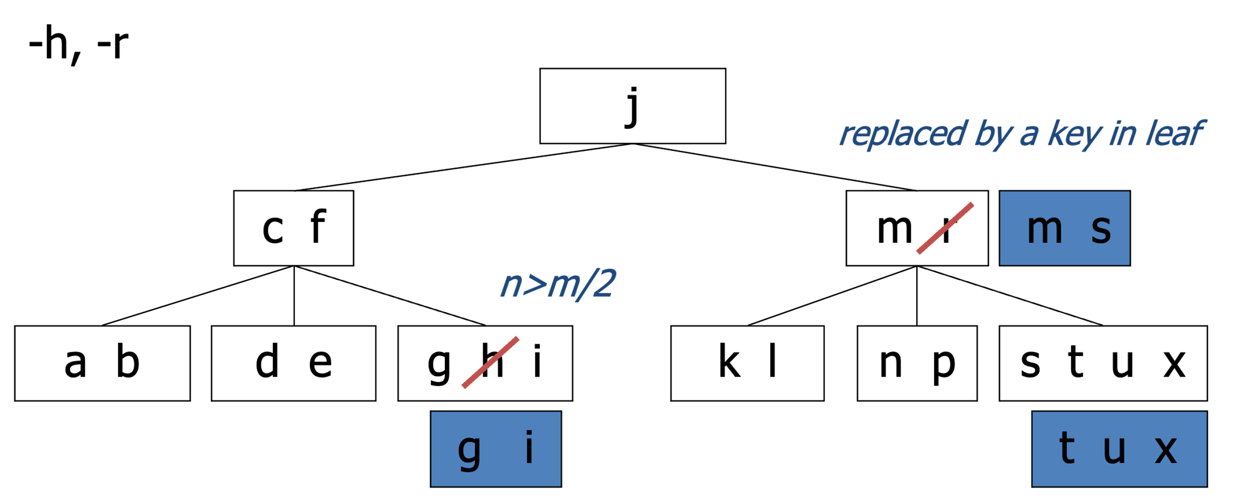
Operations : Search, Insert, Delete
4 – 5 Tree operation : INSERTION EXAMPLE

Slide 38
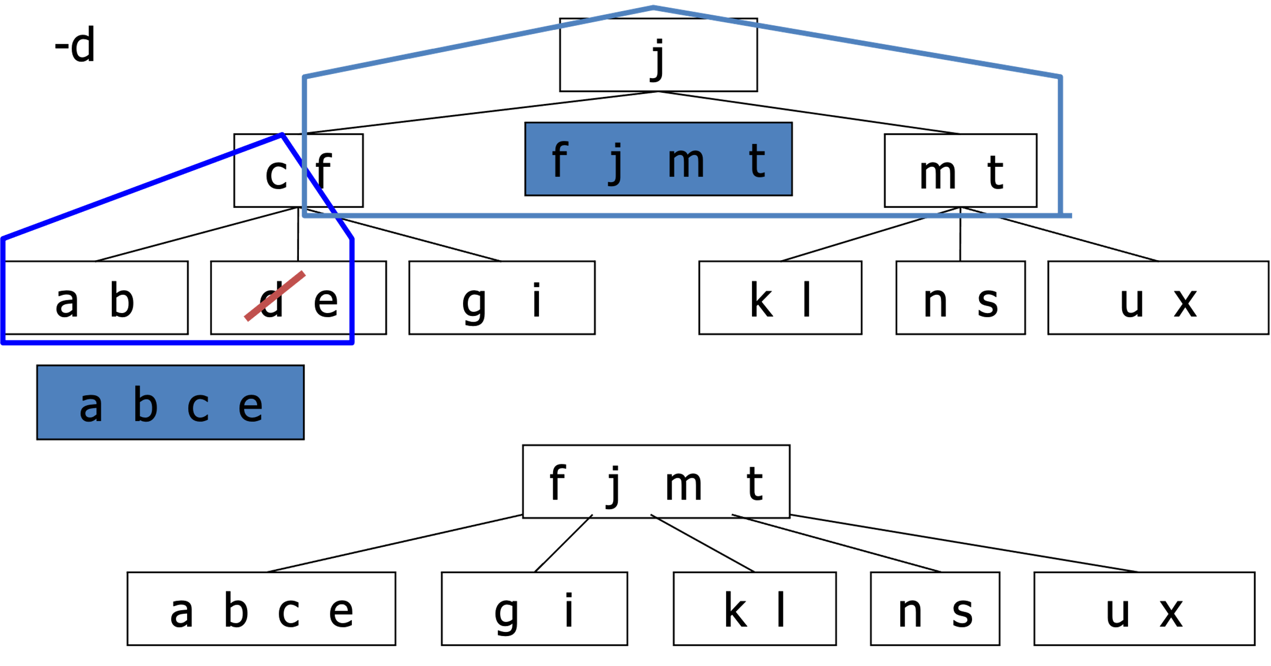
Operations : Search, Insert, Delete
4 – 5 Tree operation : INSERTION EXAMPLE
sizeof p = m/2 and sizeof q = m/2

Slide 39
References
S. Sridhar. 2015. Design and Analysis of Algorithms. Oxford University Press. New Delhi. ISBN: 9780198093695. Chapter 10
Reema Thareja. 2014. Data structures using C. Oxford University Press. New Delhi. ISBN:9780198099307. Chapter 11
Thomas H. Cormen, Charles E. Leiserson, Ronald L. Rivest, & Clifford Stein. (2009). Introduction to Algorithms. 03. The MIT Press. London. ISBN: 9780262033848. Chapter 18
B-Trees, https://www.cs.usfca.edu/~galles/visualization/BTree.html
B-Trees, https://opendsa-server.cs.vt.edu/ODSA/Books/CS3/html/BTree.html

